Slide 1

Can Copy-number variation based on targeted Next-generation Sequencing of urine pellet DNA help diagnose bladder cancer
Notes:
Name / undergradate degree /
basic Biology / motivations and rationale for this topic and what we hope to achieve

Slide 2
Bladder cancer
Epidemiology of Bladder cancer
Progression of Bladder cancer
Motivation
Urinary Biomarkers
Notes:
Rates of cancer
Need for surveillance
Motivation
Research into urinary biomarker

Slide 3
Urinary biomarkers
Proteomics
Genomics
Mutational markers
Targeted NGS
Copy-number variations
Tumour associated protein
FISH / WGS
ELISA
Notes:
Urinary biomarkers encompass a wide range of fields: proteomics, genomics, epigenetics
Proteomics looks at tumour associated proteins such as nmp22 in urine, uses techniques such as elisa
Genomics is the study of DNA, research has shown that tumour dna can be found in urine, reflecting the heterogeneity, grade and stage of cancer
Tests such as urovysion look for 10 common mutations in BC by sequencing tumour pellet DNA found in urine.
UOB BC group

Slide 4
Targeted Next-generation sequencing
How it works
Off-target reads
BAM files
Notes:
Targeted NGS – sequencing performed on select regions of the genome
The targeted NGS for our data was obtained by biotinylated probes which are complementary to the region of interest in the genome. Once the probes are added, hybridized streptavidin beads are added which capture the probe and the target of interest.
The beads are attracted by a magnet and the unbound segments of the genome are washed away.
The remaining genetic material is then sequenced.
Process is not entirely effective
Off-target reads
BAM files – output format

Slide 5
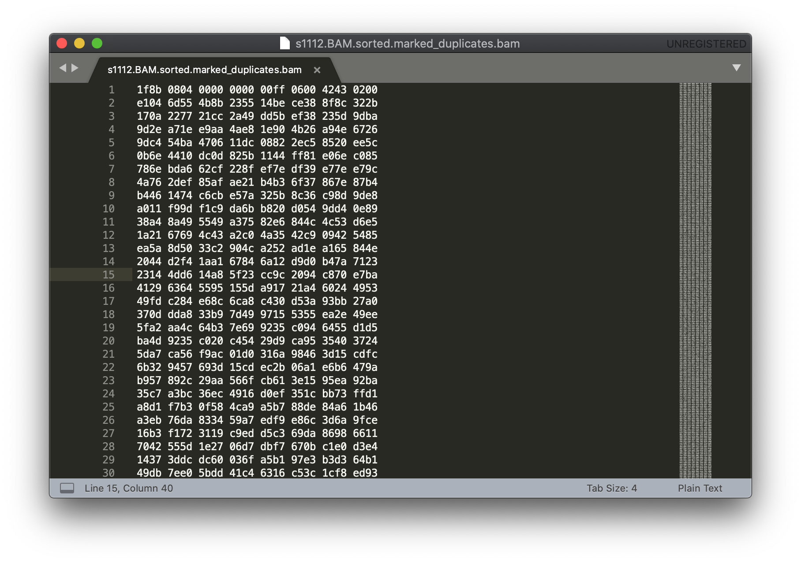
Notes:
A BAM file (.bam) is the binary version of a SAM file. A SAM file (.sam) is a tab-delimited text file that contains sequence alignment data.
Produced by aligning the raw FASTQ file to a reference genome
Binary format showing the alignment data

Slide 6
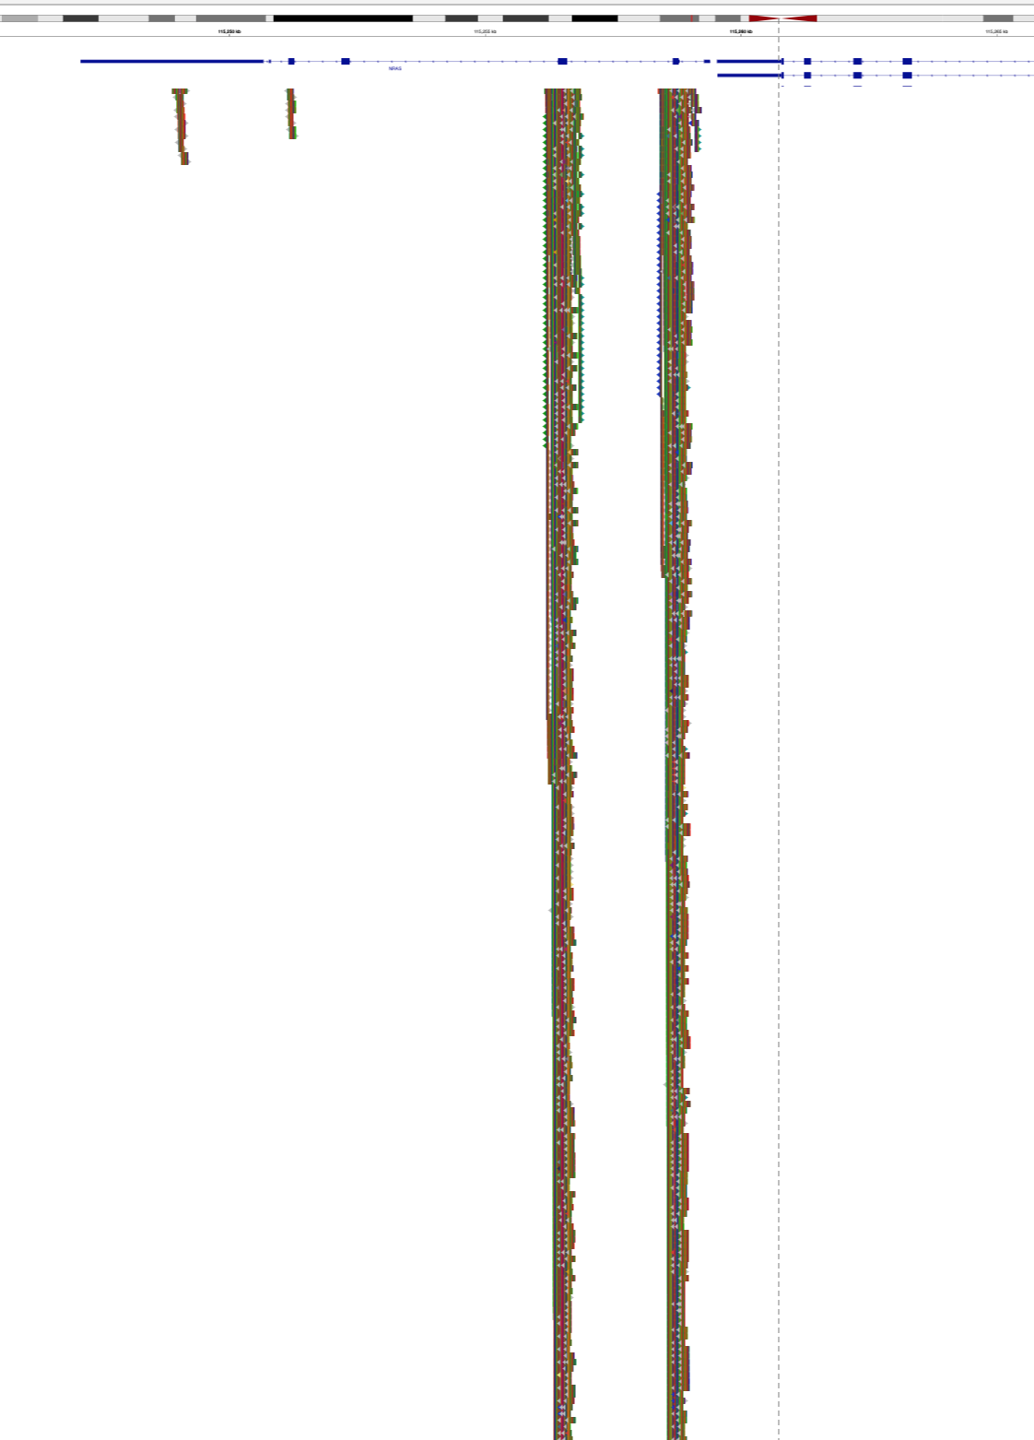
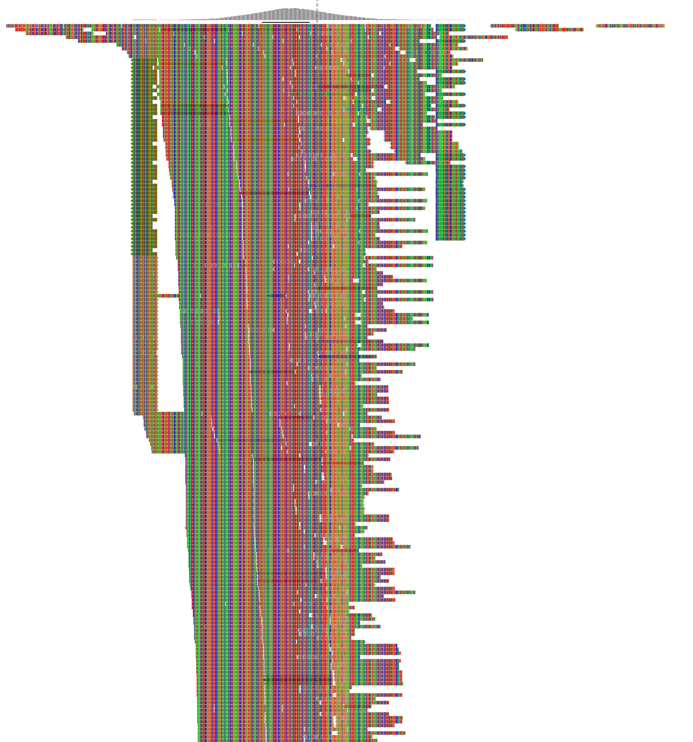
chr1 115256528 115256529 NRAS_Q61
chr1 115258746 115258747 NRAS_G12/13
Notes:
Cancer sample NRAS gene on chromosome 1
Sequence in very high depth
Base pair locations

Slide 7
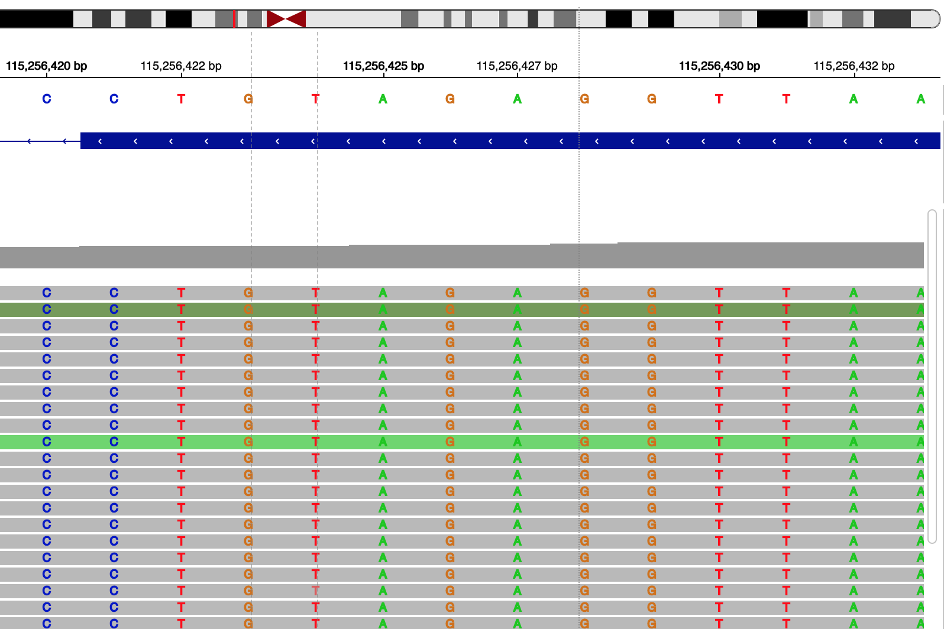
Notes:
At a higher resolution
We are able to identify the nucleotide sequence for our results
Research question: can we use the off target reads to identify CNVs from our targeted ngs data?

Slide 8
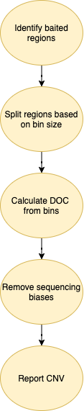
Read
depth :
3 | 3 | 4 | 4 | 4 | 4 | 5 | 5 | 5 | 5 | 5 | 5 | 5 | 5

Slide 9
Read Depth :
3 | 3 | 4 | 5 | 5

Slide 10
CNV analysis
Accounting for sequencing biases
GC regions
Repetitive regions of human genome
Normalisation to panel of normal

Slide 11
CNV segments
Notes:
The first graph shows the cnv changes from one sample
The x plot shows the chromosomes in the human genome and the y axis is the log of the copy number ratio
Each point represents the copy number ratio of a bin – a set number of nucleotide bases
The orange line reports segments of the genome, made up of grouped bins with similar copy number ratios
In the second digaram cnvs for the same sample are identified and its location in the chromosome is shown

Slide 12
Cancer samples vs normal samples
Notes:
These plots show the CNVs across the entire genome for 2 cancer samples and 1 normal sample
The x plot shows the chromosomes in the human genome and the y axis is the log of the copy number ratio
Each point represents the copy number ratio of a bin – a set number of nucleotide bases
The orange line reports segments of the genome, made up of grouped bins with similar copy number ratios
As we can see: the two

Slide 13
Copywriter
Bin: 20k
Bin: 100k
Bin: 500k
Bin: 1 mil
Bin: 2 mil
Notes:
Changing bin sizes as a hyper parameter
As we increase the bin size we reduce the noise of the plots

Slide 14
Heatmap of cnv across all samples
Non-tumour
Tumour
Notes:
In tumour we see particular chromosome with consistent copy number variations

Slide 15
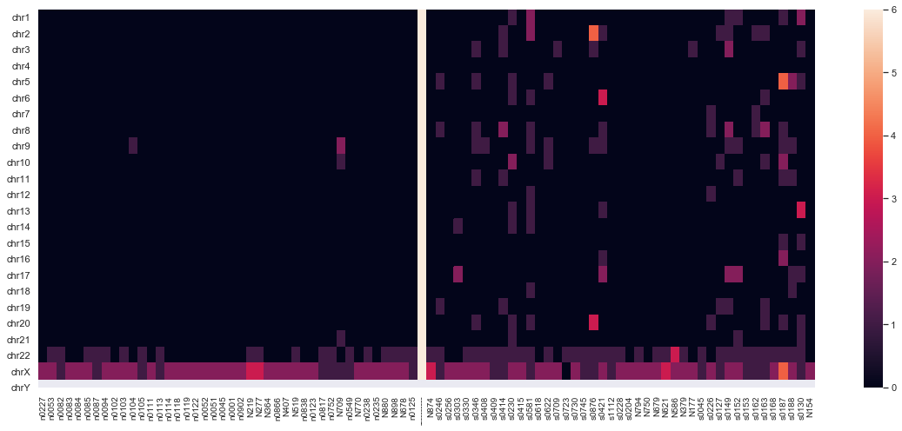
Notes:
Discrete copy number changes calculated from log values

Slide 16
ML
Notes:
Second part of the

Slide 17
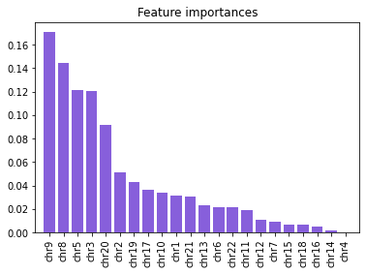
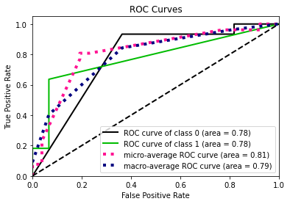
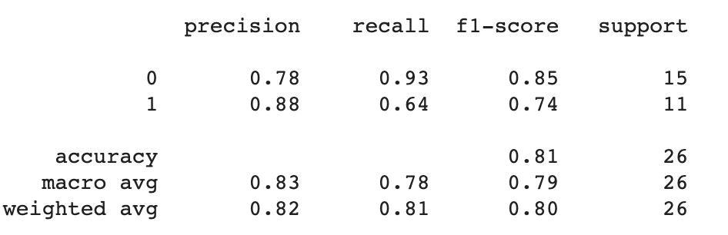
Random forest
Notes:
Random forest is an ensemble classification model that works by constructing a multitude of decision trees in training and outputting the class that is the mode of the classes of the individual trees.
Applies the general technique of bagging – trees are fit with a random sample with replacement of the training set
Feature importance – remains consistent with other studies

Slide 18
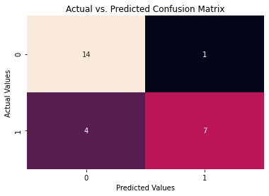
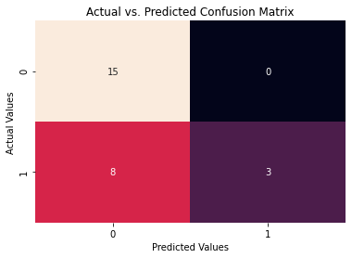
Prediction based on 2 mil bin size
Prediction based on 5 mil bin size

Slide 19
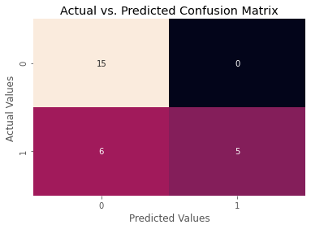
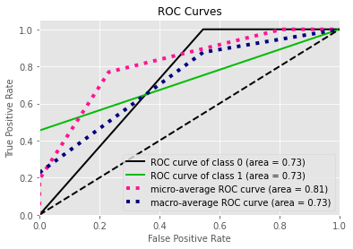
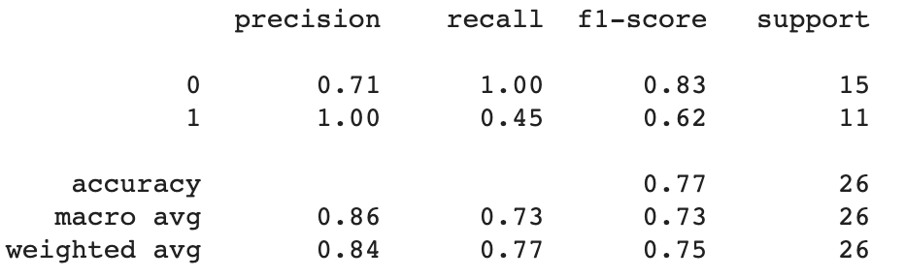
SVM
Notes:
Supervised vector model represents the examples as points in space, mapped so that the examples of the separate categories are divided by a clear gap that is as wide as possible. known as the optimal hyperplane
New examples are mapped in the same space and are classified depending on which side of the line they fall on.
SVM can efficiently perform a non-linear classification by mapping the inputs into high-dimensional feature space.

Slide 20
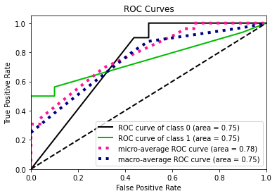
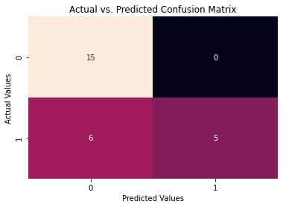
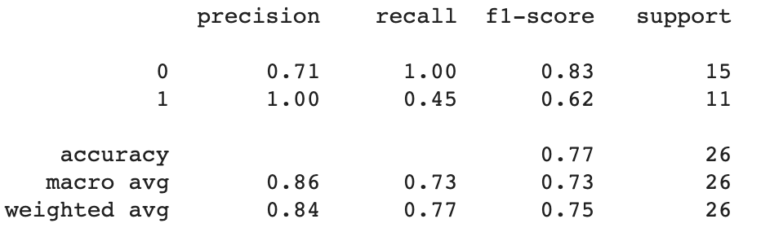
Neural network
Prediction using 5 mil bin size – NN showing greater recall when predicting tumour and higher precision prediction non-cancer

Slide 21
limitations
Sample size; due to covid
Many NMIBC do not show CNVs
Some CNVs are commonly found in normal cells

Slide 22
Conclusions
Able to extract CNV profiles from targeted NGS data
CNV data from tumour patients show greater difference in variance compared to non-tumour samples
ML algorithms show very high sensitivity when classifying tumour
CNV analysis from targeted NGS data can be used alongside mutational analysis to support bladder cancer diagnosis and surveillance

